Slide 1

CAKE Presents PIE
By: Colin Harrison, Christian Mcmurtrie, Timothy Nahkisa, and Zachary Rivera
Notes:
Introductions: Hi my name is ...
Colin: ... and we make up the CAKE group. We are working on a website that we plan to call PIE.

Slide 2
Introduction
CAKE Group (Computer Applications Knowledge and Experience)
Colin Harrison: Scrum Master/QA
Christian McMurtrie: Documentation/Dev
Tim Nakhisa: Dev/Research
Zac Rivera: Version Control Systems Manager/Dev
Notes:
Colin: CAKE stands for Computer Applications Knowledge and Experience and PIE is an acronym for Personal Interactive Expeditions. We have been working with our client Dr. Yvonne Chueh and our faculty mentor Dr. Ed Lulofs to develop a website that will aid the elderly community that is facing social isolation. This site will promote social activities and outings by allowing members to easily plan activities with other members and possibly, in the future, with volunteers and donors. The simple design should allow easy navigation of the site, easy-to-use scheduling tools, and more.

Slide 3
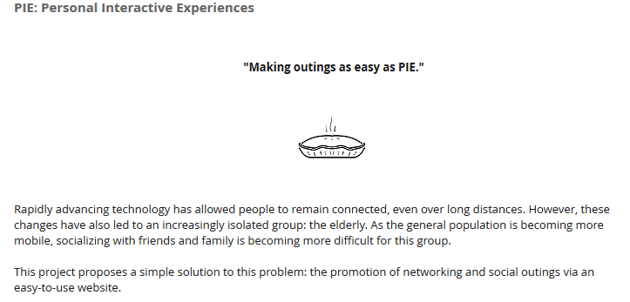
Group Website
http://www.caketeamcwu.wix.com/CAKE
Notes:
Our team website was created using a free website editor called wix. All images are royalty-free. The "About" section explains who our group is, what we are working on, and why. The "Project" tab has a brief explanation of our project. It also has a drop down menu that is activated by hovering over "Project". This allows you to view the "Agendas" tab, which shows our client, faculty mentor, and group meetings. The "Repository" tab includes a link our team's repository, links to individual sections of the repository, and a list of past commits. Under the "Scheduling" tab you can see what each of the team members is currently working on as well as lists of major upcoming tasks and completed tasks. There is also a list of "forseen difficulties" that shows some possible problems that we may run in to over the course of the project. Finally, the contact tab contains pictures of each of our group members, our current roles, and some of our contact information. The message box below is linked to our group gmail account, so any messages sent will be accessible by any member of the group.

Slide 4
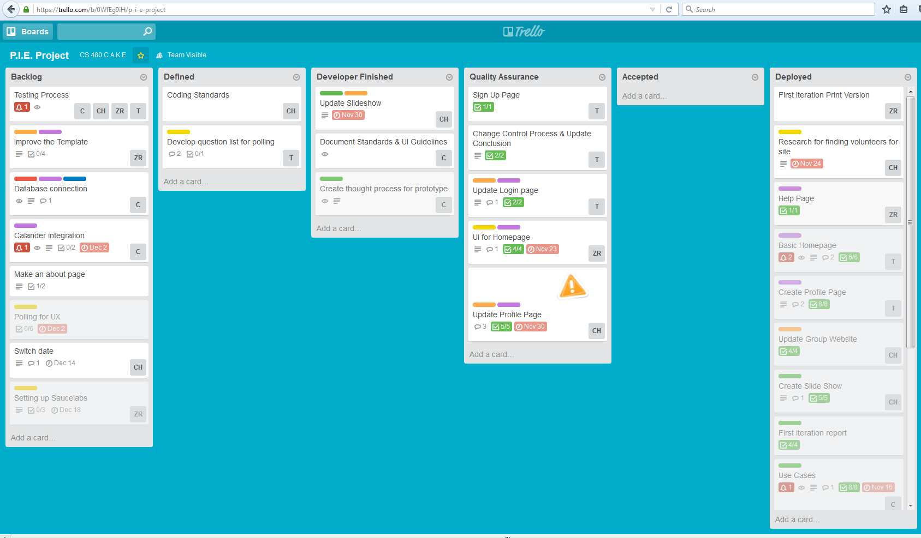
Kanban/Scrum

Slide 5
Project
PIE Project (Personal Interactive Expeditions)
Client: Dr. Yvonne Chueh
Faculty Mentor: Dr. Ed Lulofs
Goal: To develop a website that will aid the elderly community which is facing social isolation.
This site will promote social activities and outings
The simple design should aid with navigation, scheduling, and more

Slide 6
Challenge
Seniors are facing social isolation
No site designed for seniors to engage in social outings
Current sites not tailored to meet challenges of aging community

Slide 7
Solution
Developing a website that encompasses senior social activities locally.
Minimize site learning curve
Connect with local businesses to promote events

Slide 8
ABOVE INTRO BELOW PROJECT REQS

Slide 9
Requirements
Hardware and Software
Computers with Widely-used Browsers Installed
HTML, CSS, JavaScript, PHP, and MySQL
User Interaction
Functional Requirements
Nonfunctional Requirements
Feasibility
Notes:
Timo: As stated in the project management plan, we will need computers with multiple browsers and editors for web development languages and SQL. The user will interact with the site by being able to see other people in the area that want to host or plan a meal event. They will be able to request or accept invitations to these events. This information will be located on the user's homepage for easy accessibility. The user will also be able to upload photos or videos that they want to store or share. The functional requirements include two main sections: primary (or necessary) functions, and secondary (or nonessential) functions. The main functional requirements that we will be working on are: hosting the website on a server, creating a database to store user information, adding a calendar to organize user activities, implementing a background check or other security measures, and creating and designing the website. When the primary requirements are completed, we will work on a paid version, adding donations, and more. The nonfunctional requirements include efficiency, reliability, and ease of use. We believe that we will have a working product by the end of winter quarter. However, there are a lot of secondary functions that Dr. Chueh has mentioned that we may or may not be able to complete. (If you want, you can add the use case diagrams or something and just walk through those for user interaction .)

Slide 10
Hardware and Software
Optimize for most prominent browser.
Compatible with older versions.
Using HTML, CSS, JavaScript, PHP, MySQL
MySQL Database
Hosting site

Slide 11
Project Requirements
Easy to use interface
Create account
Create Groups
Create Events
Invite Family/Friends
Post and share photos
View local events
Special local deals

Slide 12
Project Management Plan
Project Organization
Scrum/Kanban process (Trello)
Risk Analysis
Feature Overload
Hardware/Software Requirements
Project Schedule
Reach new milestones each 2-week sprint
SCRUM meetings and Client Meetings
Notes:
Zach: We have been using an agile Kanban method for the project organization. Kanban is a method where group members can post tasks, or small portions of the project. Those tasks are then taken through a cycle of development and quality assurance until they are accepted. (Maybe show trello). Our team roles consist of 3 developers and one quality assurance supervisor. Each member also has a secondary role such as SCRUM Master, Documentation Manager, or Version Control Manager. Each member will cycle through each role in order to get the most experience out of this project. Our main concern in this project is feature overload. Our client wants a site similar to Meal Train with donations, a paid version, translations for international users, and more. While we will focus on the necessary functionalities first, we have to make sure we aren't bogged down with unnecessary tasks. The hardware and software we will be using is mainly computers with widely-used browsers, such as Firefox, Chrome, and Safari. We will also be using web editing software to create the site and SQL to manage any databases. We plan to reach new milestones during each 2-week sprint. We will also be having weekly group meetings, weekly meetings with our faculty mentor (Professor Lulofs), and client meetings every other week.

Slide 13
REQS ABOVE PROTOTYPE DEMO BELOW

Slide 14
Prototype

Slide 15
PROTOTYPE ABOVE QA RISK ANALYSIS BELOW

Slide 16
QUALITY ASSURANCE

Slide 17
Risk Analysis
Issue | Impact | Feasibility | Weighted | Priority
Compatibility | HIGH | Definite | 1 | HIGH
Readable Text | HIGH | HIGH | 1 | HIGH
Share Photos | MED | HIGH | 3 | HIGH
Pay Option | LOW | MED | 7 | LOW
Mult Lang | LOW | LOW | 10 | LOW

Slide 18
Conclusion

Slide 19
QUESTIONS?

